Slide 1
L20 – Graphs (finish MST, Euler, Hamilton)
7/24/24

Slide 2
Announcements
QZ06 tomorrow
All graph content L18-L20 (everything)
EX11 due tomorrow
Final exam Tuesday, 7/30, 11:30 AM - 2:30 PM in this classroom

Slide 3
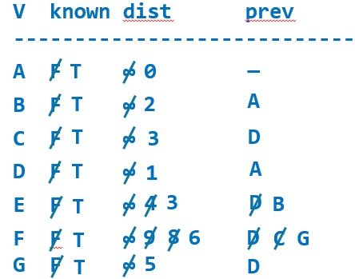
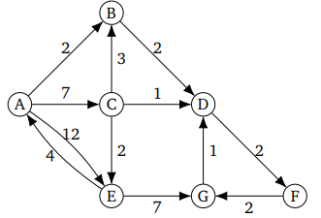
Dijkstra’s algorithm simulation
Run Dijkstra’s algorithm on this graph starting from A
Use our column names from yesterday
Graph from here

Slide 4
Solution
PQ
(0, A)
(2, B) (7, C) (12, E)
(4, D) (7, C) (12, E)
(6, F) (7, C) (12, E)
(7, C) (8, G) (12, E)
(8, G) (9, E) (12, E)
(9, E) (12, E)
(12, E)
Empty
Output: (0, A) (2, B) (4, D) (6, F) (7, C) (8, G) (9, E)
Vertex | Known | Dist | Prev
A | T | 0 | -
B | T | 2 | A
C | T | 7 | A
D | T | 4 | B
E | T | 12 9 | A C
F | T | 6 | D
G | T | 8 | F

Slide 5
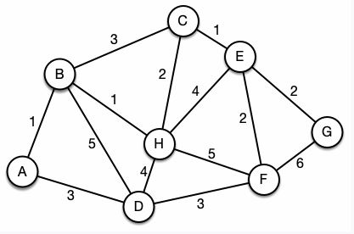
Kruskal’s alg practice problem
Given this graph, construct an MST using Kruskal’s algorithm.
What is the sum of its edge weights?
12

Slide 6
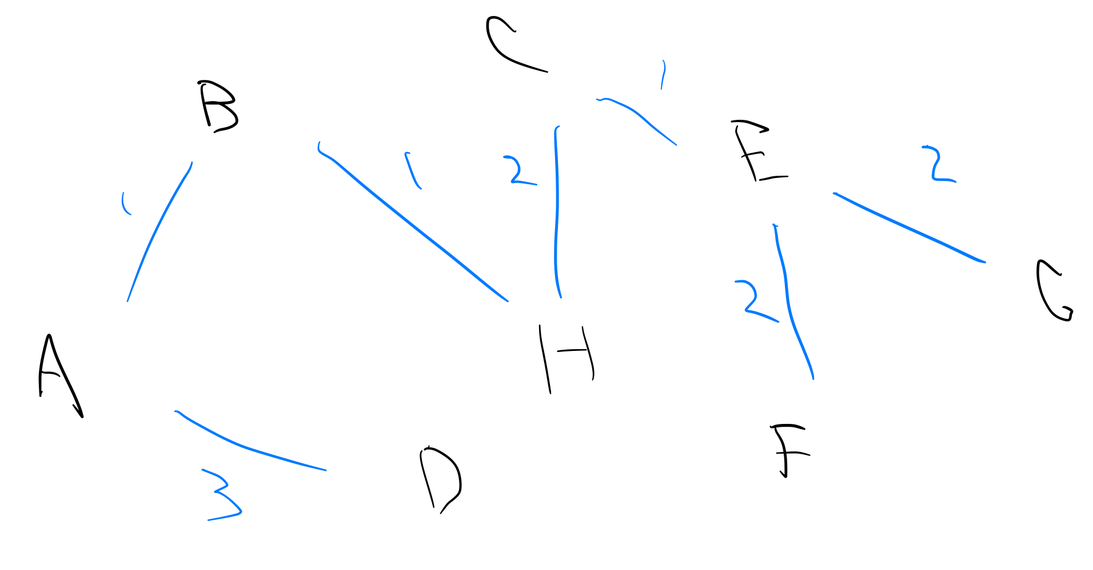
(One) solution
How many MST(s) could Kruskal’s algorithm generate for this graph?
2
We used all the 1 and 2 edges, so the final edge must be a 3-edge. It can’t be {B, C} (cycle) but could be {A, D} or {D, F}

Slide 7
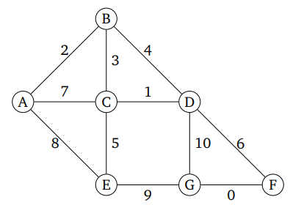
Prim’s alg practice problem
Given this graph, construct an MST using Prim’s algorithm starting on node A
Edge
(A, B)
(B, C)
(C, D)
(C, E)
(D, F)
(F, G)
Notes:
MST sum 17

Slide 8
Knowledge questions
For this graph, if we had started on a different node with Prim’s or if we had used Kruskal’s algorithm, would we have gotten the same result?
In which algorithm is it simpler (i.e., simpler implementation, not necessarily more efficient) to detect cycles: Kruskal’s or Prim’s?
Yes, note from yesterday that a graph with distinct weights has a unique MST
Prim’s. Note from yesterday that the algorithm simply requires that the destination node not be in the MST already. Implement simply with HashSet/HashMap contains method. Since Kruskal’s starts with all nodes, this approach is not possible (use disjoint set)

Slide 9
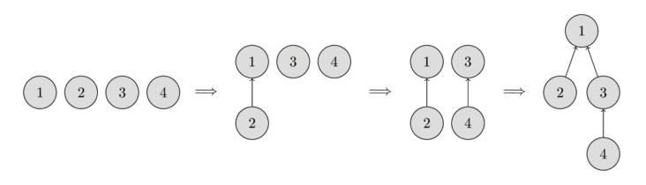
Disjoint set
1, 2, 3, 4 are first each in different disjoint sets
Then merge 1 and 2 into {1, 2}
That set’s representative element is 1
Then merge 3 and 4
Leader 3
Then merge {1, 2} and {3, 4}
Leader 1

Slide 10
Disjoint set interface
make_set(v)
Create new set consisting of v
find_set(v)
Returns representative (or leader) of the set containing v
Used to find if two elements are in the same set or not (find_set(a) == find_set(b))
Representative can change after union_sets call
union_sets(a, b)
Merge two sets, the set in which a is located and the set in which b is located
If a and b are in the same set, do nothing
All operations can be done in O(1)* amortized, implemented by array (which can be seen as tree, similar to heap)
Actually O(α(n)), where α(n) is the inverse Ackermann function
α(n) <= 4 for n < 10⁶⁰⁰, here are the first few entries of F(4, n)

Slide 11
More info about disjoint set can be found
here

Slide 12
How is disjoint set used in Kruskal’s for cycle detection?
Fill in the blanks using find_set(v) and/or union_sets(a, b)
algorithm Kruskal(G) is
F := ∅
for each v in G.V do
MAKE-SET(v)
for each {u, v} in G.E by increasing weight do
if ________ ≠ ________ then
F := F ∪ { {u, v} }
_______________________
return F
Pseudocode from Wikipedia

Slide 13
Kruskal’s alg disjoint set
Consider the MST made with Kruskal’s earlier
Suppose at this point we are considering the edge (B, C)
We cannot add it because B and C are in the same set (would create cycle)
Suppose (C, H) were not in our MST
Then B and C would be in disjoint sets, so edge (B, C) would be put in the MST

Slide 14
Solution
algorithm Kruskal(G) is
F := ∅
for each v in G.V do
MAKE-SET(v)
for each {u, v} in G.E by increasing weight do
if FIND-SET(u) ≠ FIND-SET(v) then
F := F ∪ { {u, v} }
UNION(FIND-SET(u), FIND-SET(v))
return F
Pseudocode from Wikipedia

Slide 15

7 Bridges of Konigsberg
Can you walk through the city and cross each bridge exactly once (either direction)?

Slide 16
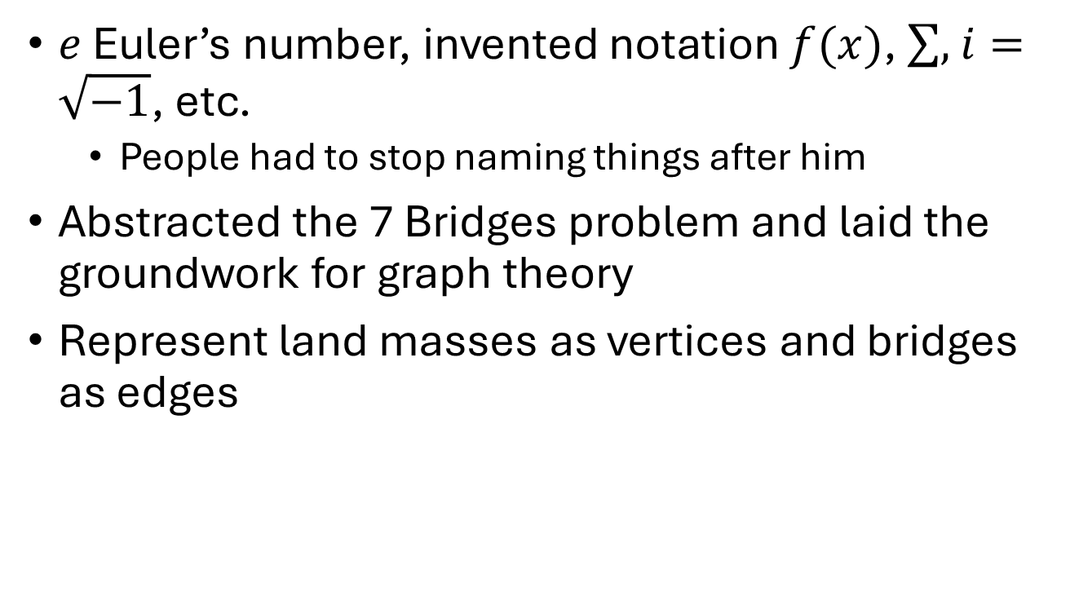
Leonard Euler
$e$ Euler’s number, invented notation $f(x)$, $\sum{,}$ $i=\sqrt{−1}$, etc.
People had to stop naming things after him
Abstracted the 7 Bridges problem and laid the groundwork for graph theory
Represent land masses as vertices and bridges as edges

Slide 17
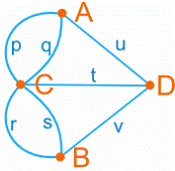
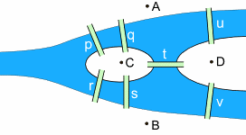
Simplified representation
Can a person execute a walk that crosses each bridge once and only once? Can start anywhere and end anywhere
Put a pen on any vertex. Can you trace the diagram without picking up the pen and without redrawing an edge?

Slide 18
Euler path and circuit
Euler path (EP)
Path in the graph that passes through each edge once
Euler circuit (EC)
EP that begins and ends on the same vertex

Slide 19
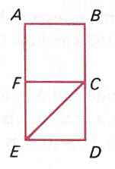
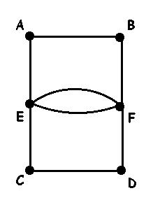
EP and EC examples
EP: F, A, B, C, F, E, C, D, E
EC: E, A, B, F, E, F, D, C, E

Slide 20
Does G have EP/EC?
To answer “Does G have any EP or EC?”, first compute degree of every vertex in G
Degree of vertex v
#edges involving v
We are talking about undirected graph with unordered edges {a, b}, so deg(v) = number of edges {v, u} ∊ E

Slide 21
Degree examples
2
3
3
4
4
4
3
3
4
3
3
2
4
4
4
4
4
2

Slide 22
Euler theorems
Given connected undirected G = (V, E)
Theorem 1: General
The sum of the degrees of all vertices in G exactly 2*|E| (thus, even)
Thus, the number of odd vertices is even
Theorem 2: EP
If G has exactly 2 odd vertices, then it has at least one EP, which must start at one odd vertex and end at the other
If G has more than 2 odd vertices, then it has no EP
Theorem 3: EC
If G has any odd vertices, then it has no EC
If G has all even vertices, then there is at least one EC
Key idea for theorems 2 and 3
Odd vertex degree 1 can be exited but not entered (start node) or entered but not exited (end node)
Odd degree ≥ 3 (2n+1), above will hold after you enter and exit that node 2n times
2 odd vertices: one is start and other is end
>2 odd: doesn’t work, can’t have more than 1 start and 1 end

Slide 23
# odd vertices
# odd vertices | implication
0 | ≥1 EC (no EP that is not EC)
1 | Impossible (th. 1)
2 | No EC, ≥1 EP where every EP starts on one odd and ends on the other
>2 | No EC, no EP

Slide 24
Euler theorem examples
2 odd
no EC
at least 1 EP
2
3
3
4
4
4
3
3
4
3
3
2
4 odd
no EP (so no EC)
4
they start, end here
4
4
4
4
0 odd
at least 1 EC
2

Slide 25
Algorithm for finding EC in O(|E| + |V|)
Won’t have you find EP/EC on assessments, will ask conceptual questions like previous slides
Algorithm here for your curiosity
Given undirected unweighted G=(V,E)
1) Start with empty tmp stack, empty EC stack
If 0 odd nodes pick any as cn, the curr node
else if 2 odd nodes pick one odd as cn, the curr node
else no EP/EC: end
2) If cn has no neighbors:
push cn to EC stack
cn = pop tmp stack
Else // cn has neighbors
push cn to tmp stack
pick any neighbor nb of cn
remove edge (cn,nb)
make nb the new cn
3) Repeat step 2 until
cn has no neighbors and tmp stack is empty

Slide 26
3D (beginning of topology)
This is a cube “stretched” or flattened to 2D
Every convex polyhedron can be projected into 2D as a connected planar graph
We can use the graph to study some properties of the cube
E.g., can a bug crawl along all edges of the cube without crossing any twice?
No
#odd vertices = 8, no EP

Slide 27
Hamiltonian path and cycle
Given undirected connected graph G = (V, E)
Hamiltonian path (HP)
Path in G that contains each vertex once
Hamiltonian circuit (HC)
HP with the same start and end vertex
HC: 1, 2, 3, 4, 5, 1
HP: 1, 2, 3, 4, 5
1
2
HC: 2, 3, 4, 5, 1, 2
3
HC: 2, 3, 4, 1, 5, 2
5
4
HP: 1, 5, 2, 4, 3
HP: 2, 5, 1, 4, 3

Slide 28
Another example
HP: 1, 2, 3, 4, 5
1
3
5
HP: 1, 4, 3, 2, 5
HP: 1, 4, 5, 2, 3
HP: 3, 2, 5, 4, 1
2
4
etc.
HC: none

Slide 29
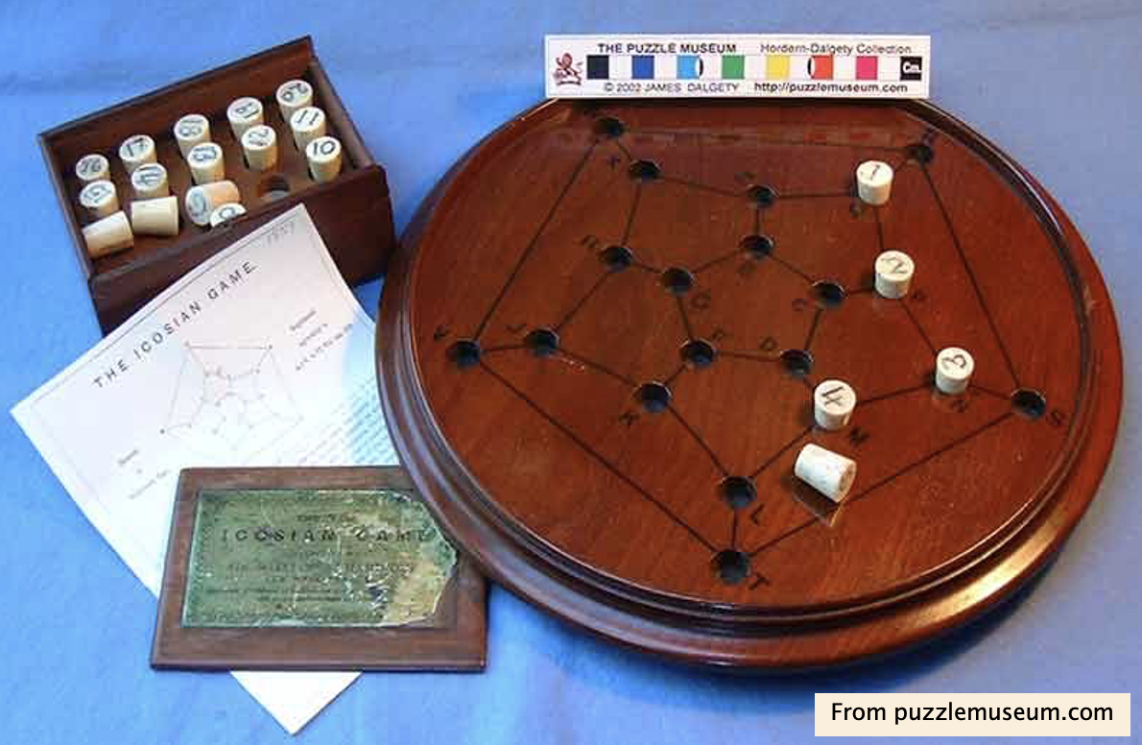
Icosian Game
Board game invented by Irish mathematician William Rowan Hamilton in 1857
Put pegs in holes to define a path that uses each hole once and ends where it starts (i.e., HC)

Slide 30
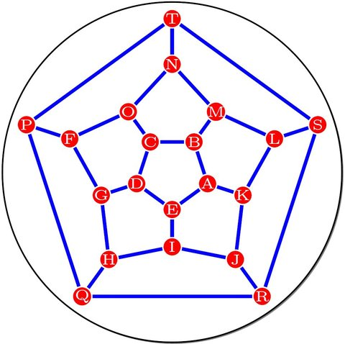
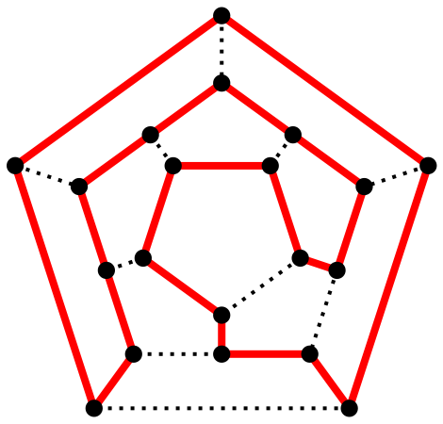
Icosian Game
Planar graph, flattened dodecahedron
There is HC for this graph

Slide 31
Hamiltonian harder than Euler
We saw O(|V| + |E|) algorithm for EP/EC construction
Hamiltonian not nearly as easy for some strange reason
Dirac 1952 (sufficient condition)
A simple graph G (no loops, no multi-edges) with N vertices is Hamiltonian if degree of each vertex is ≥ N/2
Ore 1960 (sufficient condition)
A graph G with N vertices is Hamiltonian if for every pair of non-adjacent vertices, the sum of their degrees is ≥ N

Slide 32
Efficiency: P vs. NP
No known efficient (polynomial time) algorithm for finding HP/HC
For some data, known algorithms for HP/HC take exponential time
Have not proven that HP/HC is not polynomial, just have not yet found a polynomial time algorithm

Slide 33
NP
We cannot find HP/HC in polynomial time
However, given an HP/HC, we can easily (polynomial time) verify that it is an HP/HC for a graph
See the difference
Does this G have an HC?
Y/N decision
Given this path P in G, is it an HC?
Verify
Find an HC for G
Constructive

Slide 34
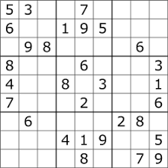
Another example of P and NP
Sudoku
Proposed solutions are easily verified
Time to check solution grows polynomially as grid gets bigger
Known algorithms for finding solutions take time that grows exponentially as grid gets bigger
So, sudoku is in NP (quickly checkable)
But seems not to be in P (quickly solvable)

Slide 35
P ≟ NP
Is the set of P questions the same as the set of NP questions?
If the solution to a problem is easy to check for correctness, must the problem be easy to solve?
A Millenium Prize Problem ($1,000,000 for solution)
Proof either way worth way more than $1000000, profound implications for math, cryptography, algorithms, etc.
We know P ⊆ NP because all problems solvable in P time have solutions verifiable in P time
Just solve problem in P and compare it to given solution
NP
Sudoku
Find HP/HC
Sorting
P
Are P and NP the same circle?

Slide 36
Example crypto application: zero-knowledge (ZK) proof
Zero-knowledge proof
One party (prover) can prove to another party (verifier) that a given statement is true, while avoiding conveying to the verifier any information beyond the mere fact of that statement’s truth
Example usage
Prove to a website that you are who you claim to be but without giving them your password

Slide 37


ZK proof example
How to prove that you know the location of Waldo but without giving away his location?
Shift this part of the board so the verifier can’t see the location

Slide 38
ZK protocol with Hamiltonian
There is a ZK protocol that involves finding and revealing a Hamiltonian cycle in a graph
Protocol wouldn’t work if we know Hamiltonian is in NP but not P, but it turns out P = NP

